Slide 1
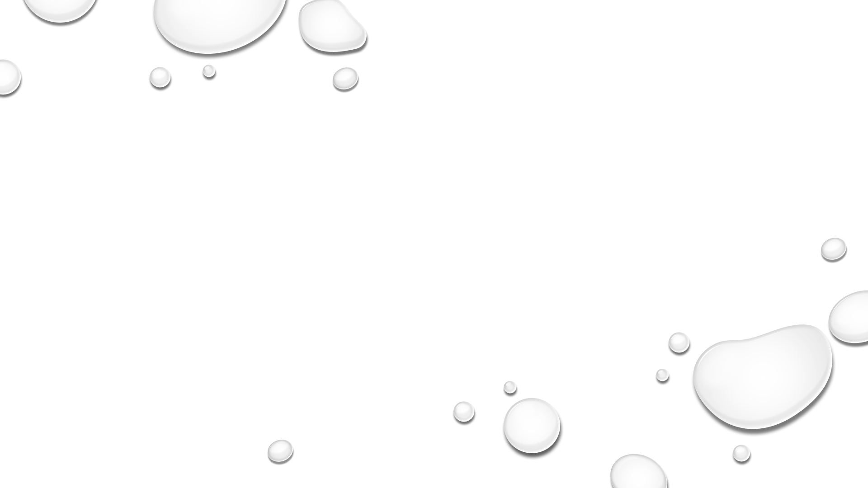
Scalable to-pdf conversion web application using serverless
Avinash kunamneni – B00982043
Shashank reddy kartnati – B00982036
Venkata purna Vishnu Vardhan kolleboyena – b00982058

Slide 2
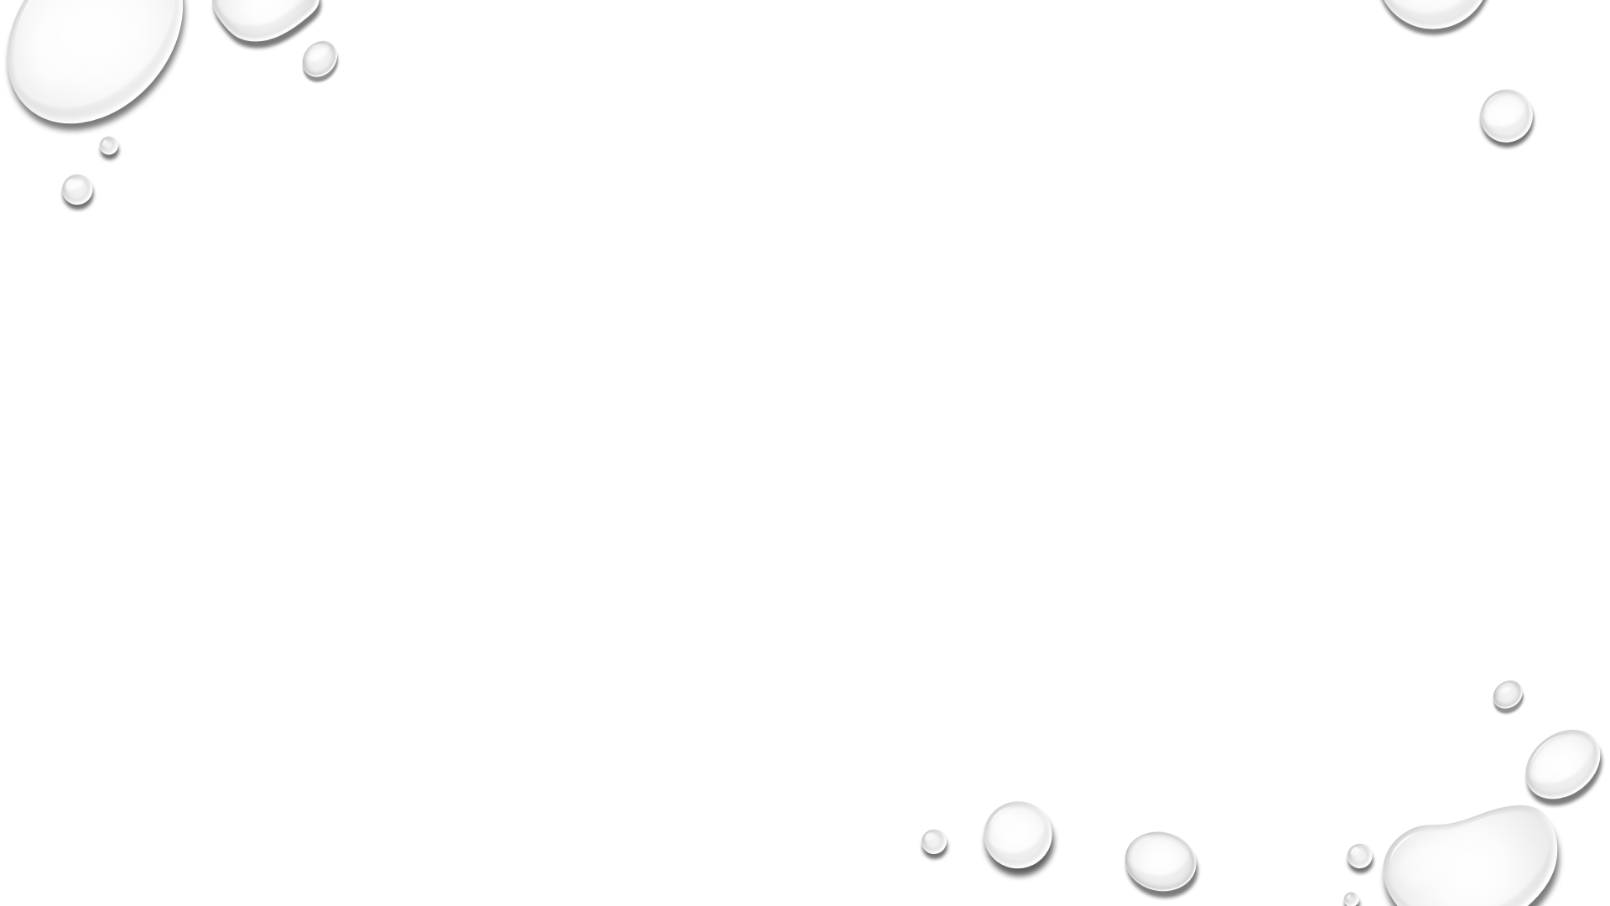
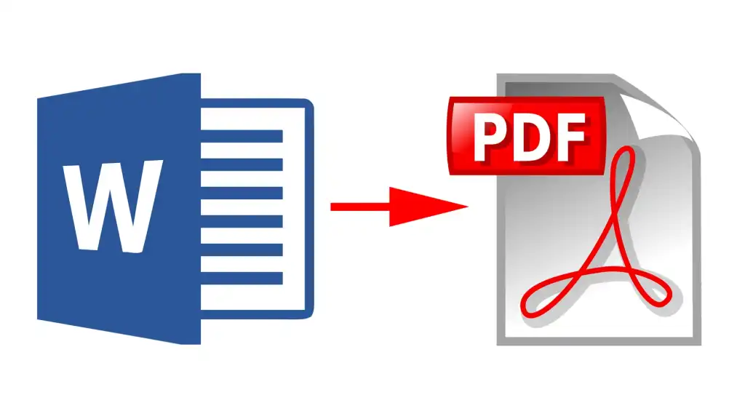
CONVERT word or excel into PDF (1)
BASIC IDEA :
We are going to build a web application which is going to convert the word documents or excel sheets into a pdf.
User will be able to upload the word/excel.
The uploaded file will be converted into pdf.

Slide 3
CONVERT word or excel into PDF (2)
This is a simple legacy application which we are going to build in python.
Using simple python http server, we will initially host it in the local system.
Tech usage: html, css, python, Docker, K8S, Google Functions, Google cloud run

Slide 4

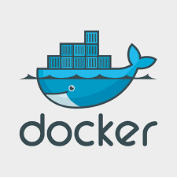
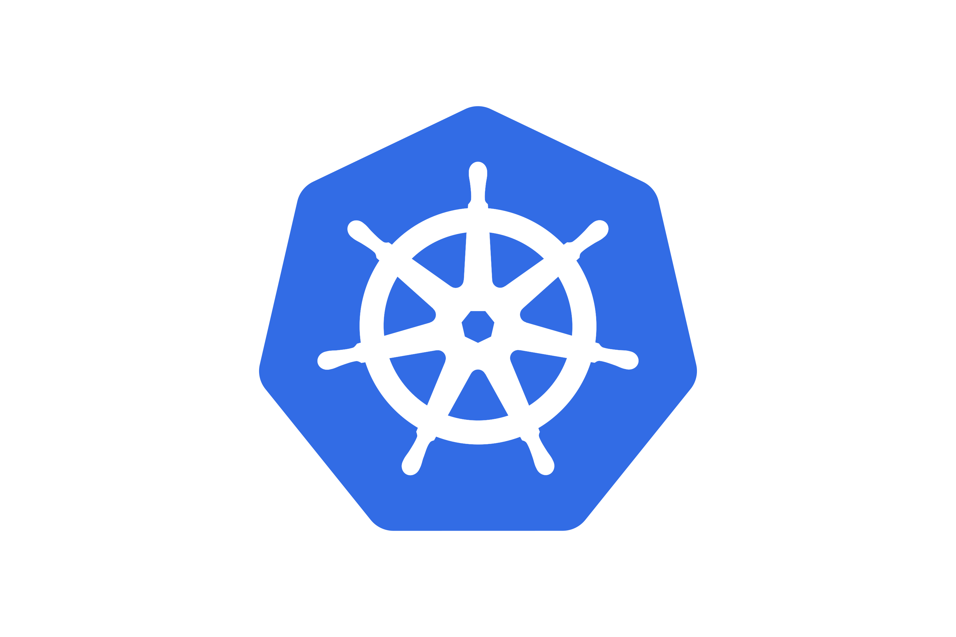
Host on local system vs containers
Create docker image for the application.
Run it in the docker containers
Deploy it to the Kubernetes cluster.

Slide 5
Serverless vs containers
Both serverless computing and containers enable developers to build applications with far less overhead and more flexibility than applications hosted on traditional servers or virtual machines.
serverless applications are more scalable and usually more cost-effective..

Slide 6
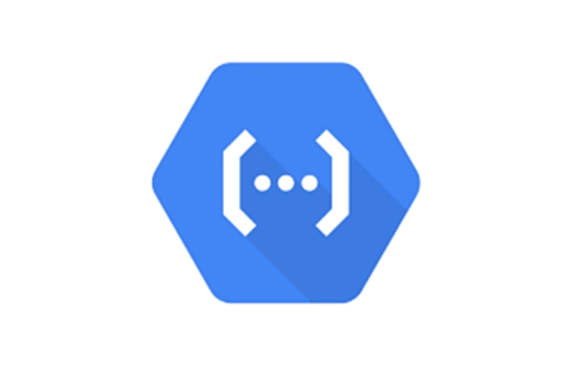
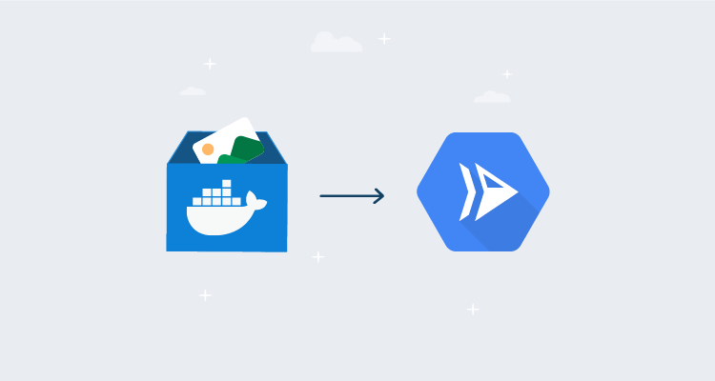
serverless
Going to utilize the serverless of components of google such as functions and cloud run.
Host the application on cloud run.

Slide 7
Serverless vs containers
Will perform a comparative study of pros and cons of using containers and serverless.
Will list out best use cases for going to serverless based on our project observations.
Scalability study of Kubernetes and cloud run.

Slide 8
Thank you

